Slide 1
Data Mining and machine learning
Project presentation
Arnaud Bonvin
Tarald Dysthe
Vakisan Tharmakulasinkam
Data Mining and Machine Learning
Semester of Fall 2021
20th December 2021

Slide 2

Plan
Baseline results
Our model
Features and improvements
Final results

Slide 3
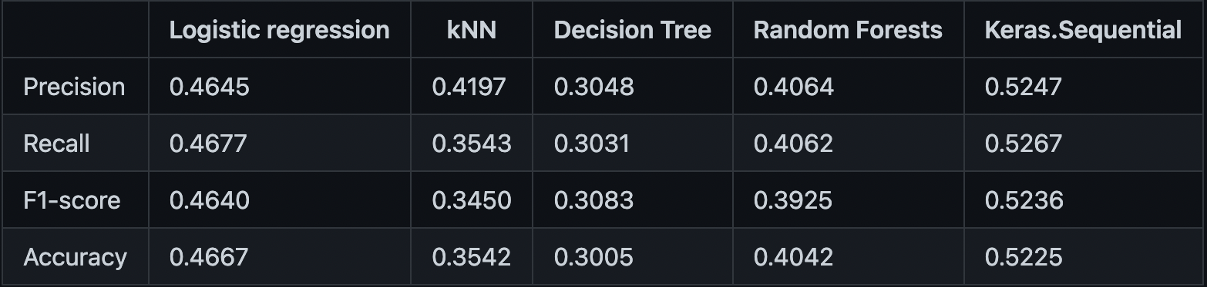
Baseline results
After testing, it was clear that the best model for predicting was the model we chose, followed by the linear regression:

Slide 4
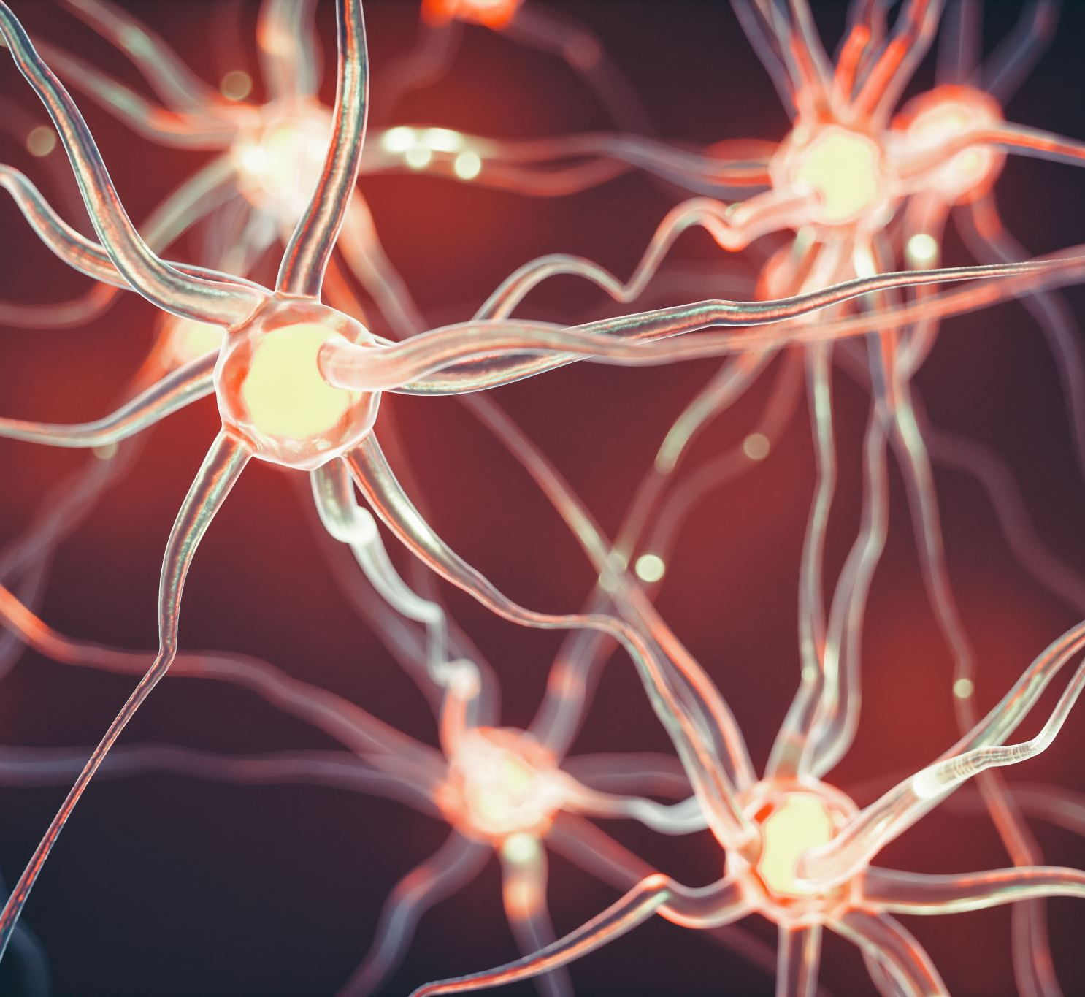
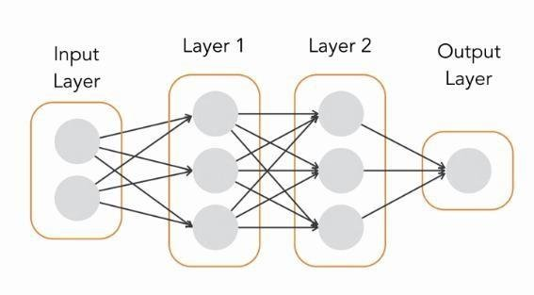
Our model
The model we chose to use was a deep learning sequential model from the library Keras
Keras is a high-level deep learning API which is very easy to use (from tensorflow)
In short, a sequential model is a model which uses computational graphs formed by layers of neurons that break down complexes equations into simpler and smaller ones. These neurons are linked by what are called synapses.
Each neuron has its own activation function to create a nonlinear decision boundary

Slide 5

Features
word_len_counter
Returns the number of words and characters in a sentence
type_counter
Returns the number of each type of word in a phrase (noun, pronoun, …)
Sk_vectorizer
A simple word vectorizer from the sklearn library (used for the baseline results) + Bigrams
Vectorizer
A more complex vectorizer similar to the word2vec vectorizer (basically the same)

Slide 6
Final results
In the end, we were not able to increase much more than our final result of around 5.63
Too much layers = overfit
Bi-grams were the best fit
We did not use Keras at its full potential
Removing too much words was a bad idea as some sentences were already really short (only punctuation and proper nouns were removed).
A larger dataset would really help with the accuracy.
We could really use better hardware

